Slide 1
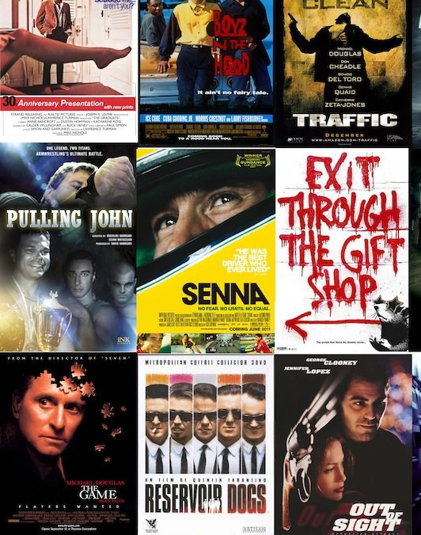
Recipe behind a Block Buster Movie

Slide 2
Contents
Background
Problem Statement
Data Analysis & Visualization
Conclusion

Slide 3
1. Background A commercial success movie not only entertains audience, but also enables film companies to gain tremendous profit. A lot of factors such as good directors, experienced actors are considerable for creating good movies. However, famous directors and actors can always bring an expected box-office income but cannot guarantee a highly rated IMDB score. The dataset contains 28 variables for 5043 movies, spanning across 100 years in 66 countries. There are 2399 unique director names, and thousands of actors/actresses. “movie_score” is the response variable while the other 27 variables are possible predictors.
2. Problem Statement
Based on the massive movie information, it would be interesting to understand what are the important factors that make a movie more successful than others. So, we would like to analyze what kind of movies are more successful, in other words, get higher IMDB score. We also want to show the results of this analysis in an intuitive way by visualization.

Slide 4
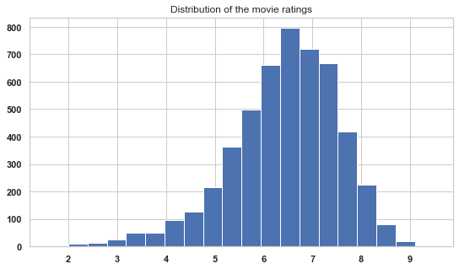
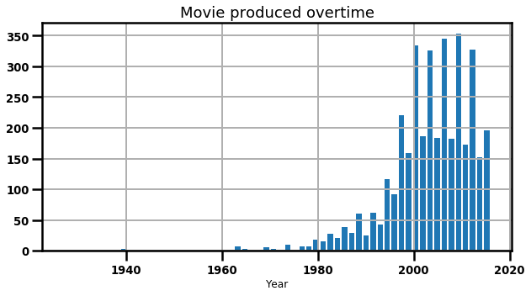
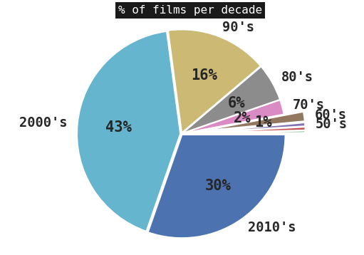
Movie Score The average movie score was found to be 6.4 Movie Release per Decade Pie chart shows the percentage of movie released every decade between the year 1916-2016, with majority being released in 2000’s
3. Data Analysis & Visualization

Slide 5
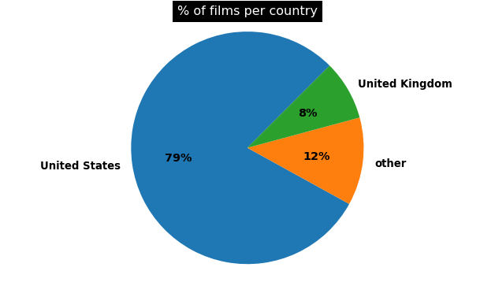
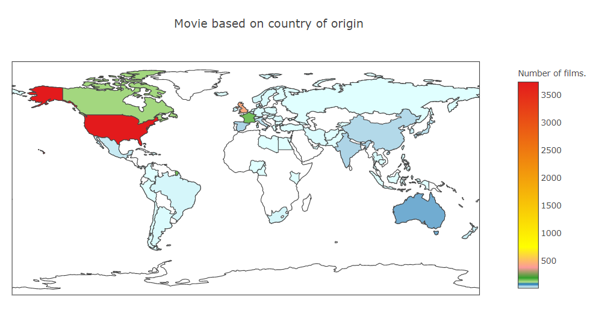
Movie release by Country Around 79% of the movies were released in USA The world map shows the distribution of movies across globe

Slide 6
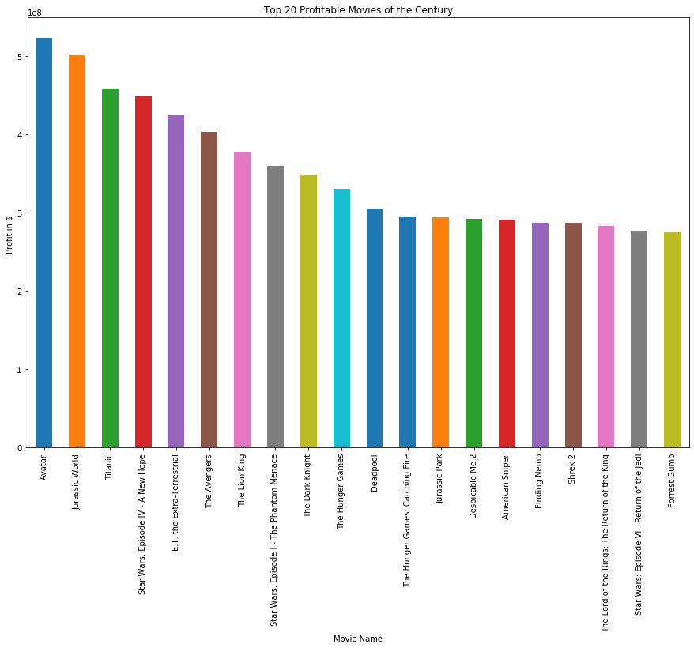
Top 20 Profitable Movies of the Century
Avatar ,Jurassic World and Titanic were the most profitable movies

Slide 7
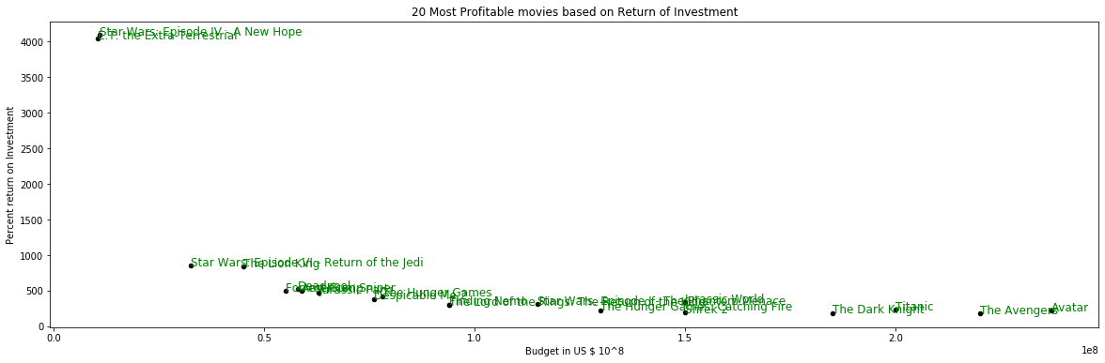
20 Most Profitable movies based on Return of Investment
As hypothesized, the ROI is high for Low Budget Films and decreases as the budget of the movie increases.

Slide 8
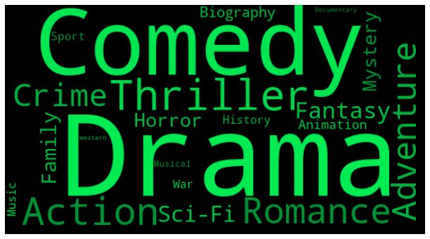
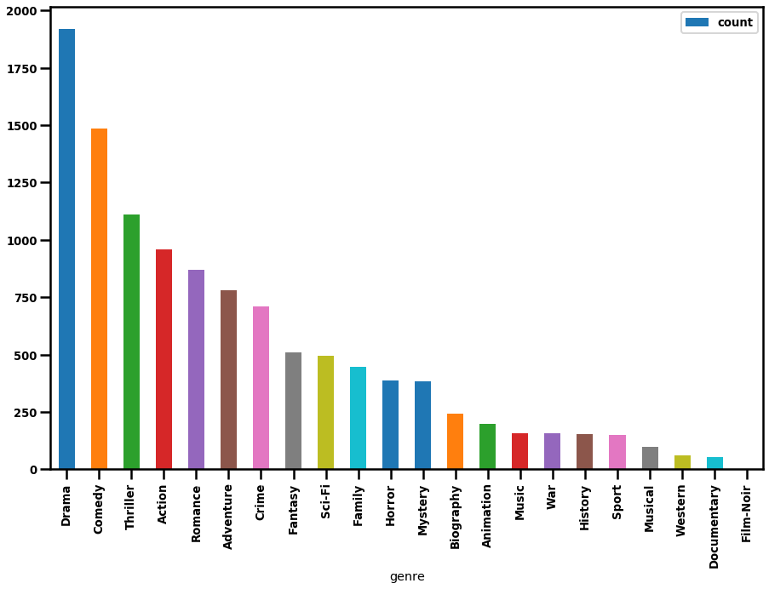
Drama, Comedy and Thriller were the top three Genres among all
Most Popular Genre

Slide 9
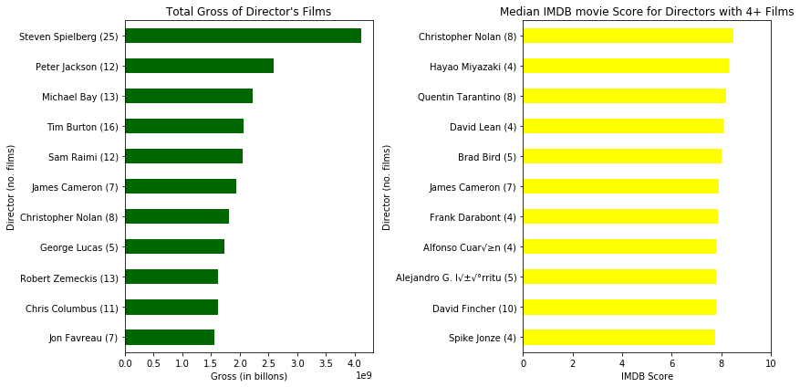
Among all the Directors Steven Spielberg seems to be producing most grossing movies and the movie produced by Christopher Nolan seems to have the highest average score
Director and their respective Gross Income and IMDB Score of Film

Slide 10
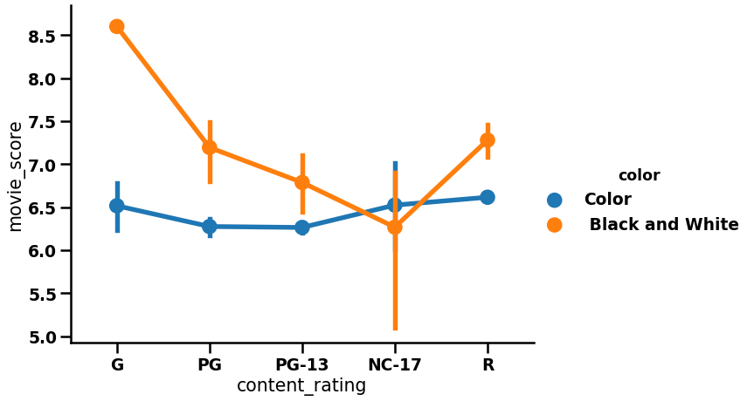
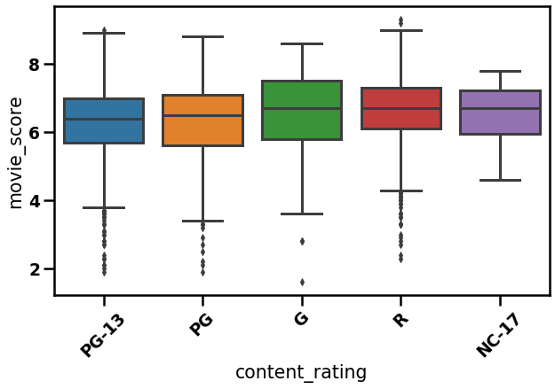
* Majority of the movies falls into the category of PG, R and PG-13. * Black & White movie recorded the lowest movie score for NC-17 rating, whereas the highest score was recorded for G rated movie. * For color movie R rated one seems to top the charts, whereas lowest score was recorded for PG-13 movie
Content Rating if the Movie

Slide 11
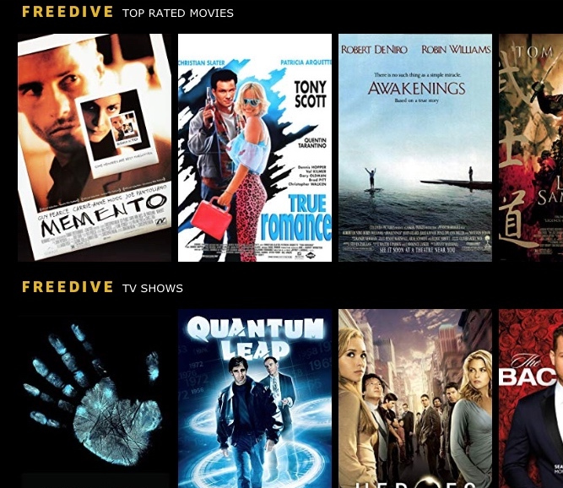
Additional observations * Only 5% of the movies were made for the black and white screen rest were color. * The average playtime of a movie was approximately 107 min. * Around 94% of movies were made in English language. *Average movie score was 6.4 with 1.6 being minimum and maximum being 9.5. * The average budget of a movie was approximately 206 million dollars.

Slide 12
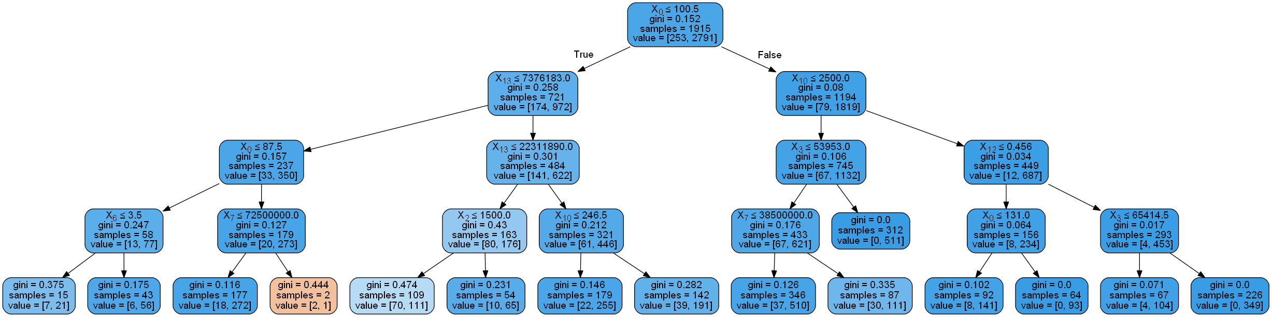
Decision Tree
Conclusion
* Movies with duration >100 min. who received Facebook likes >2500 and had high critique review ratio (>0.45) received large number of votes from the audience * Movies with duration >100 min. who received less Facebook likes and less audience votes were low budget films (<= 39 million) * Movies who had playback time of <=100 min and were top grossers(>=22 million) received large number of likes on Facebook * Movies who had playback time of <=100 and who were less grossers(<22 million) received less Facebook like for the main protagonist character(lead cast)

Slide 13
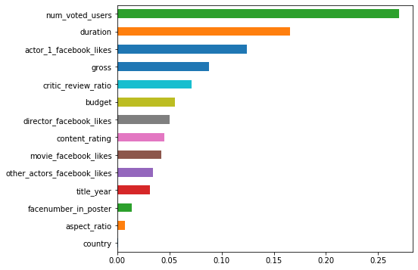
Variable Importance
Based on Variable Importance from Decision Tree, the tree most important parameters responsible for a Block Buster movie is user votes,
movie duration and likes received by protagonist character on Facebook

